Slide 1
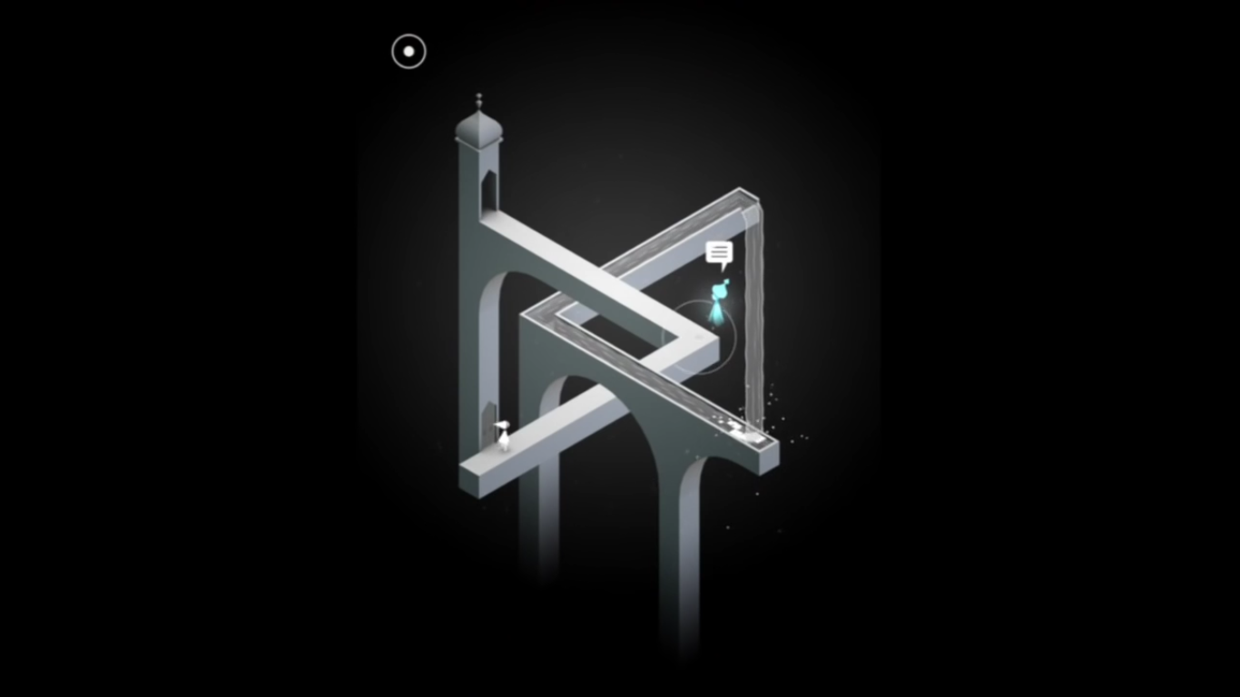
Monument Valley

Slide 3


Slide 4
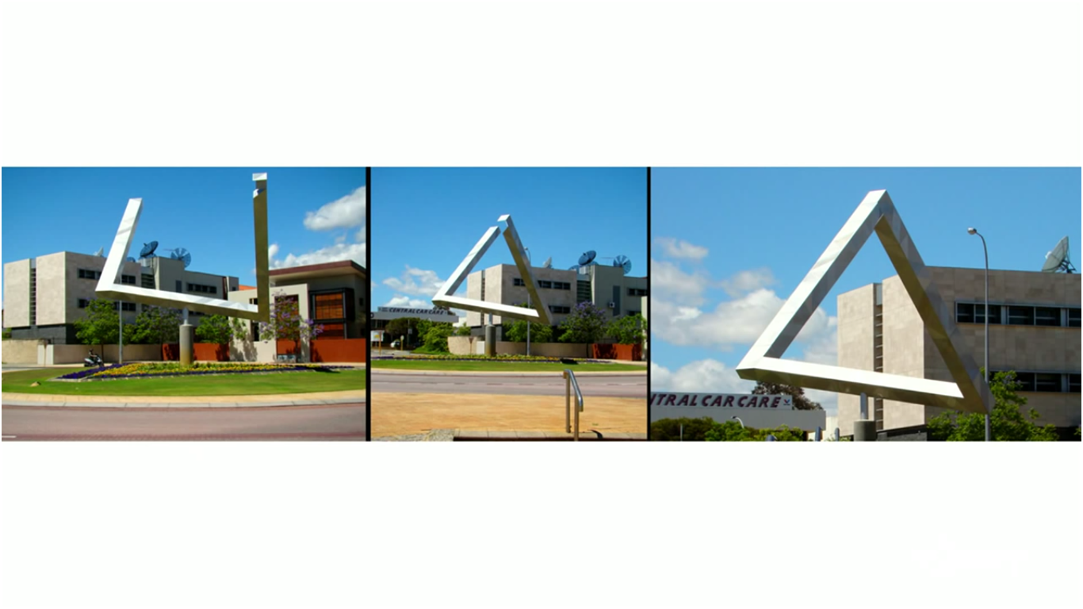

Slide 6
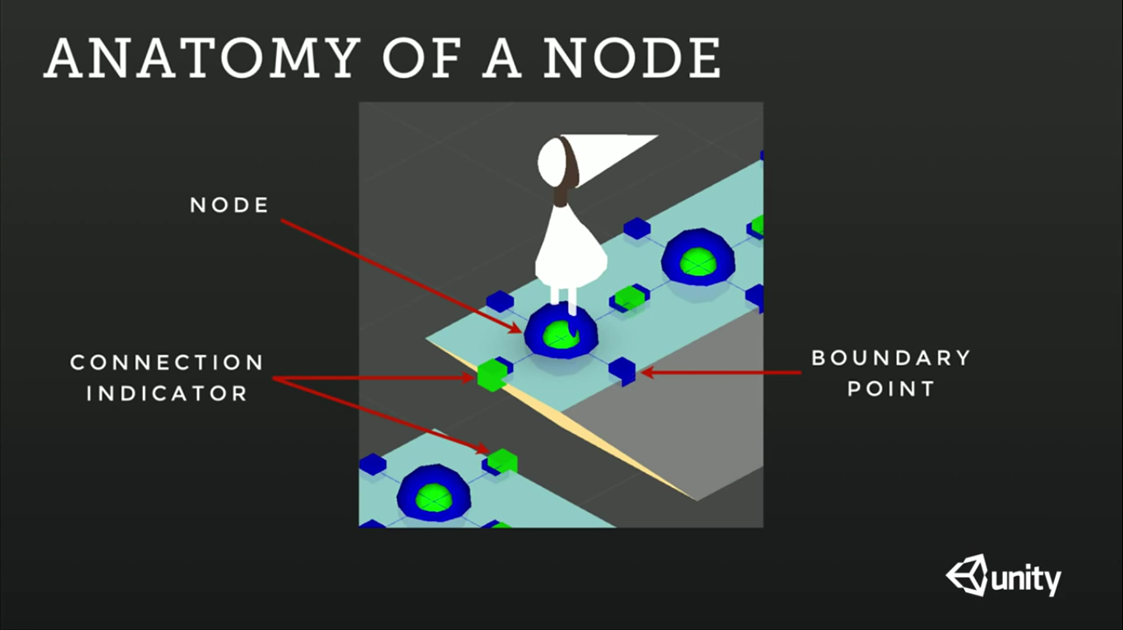

Slide 7
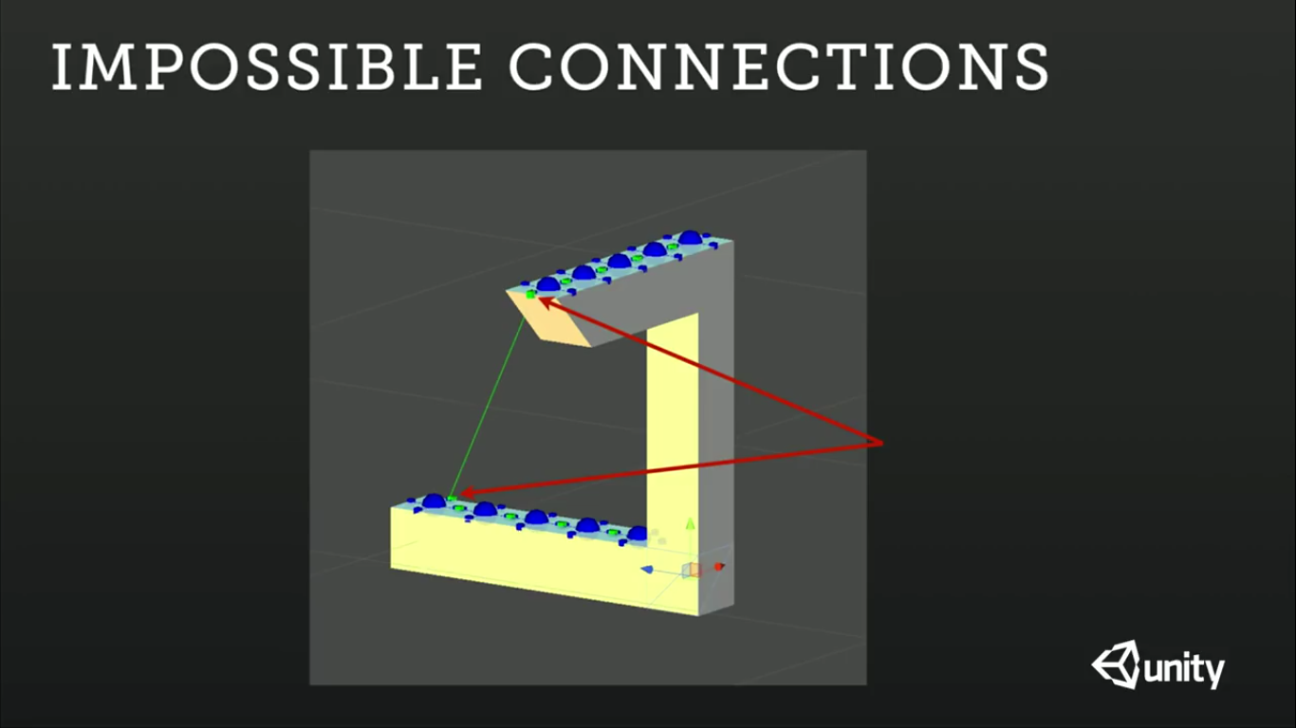

Slide 9
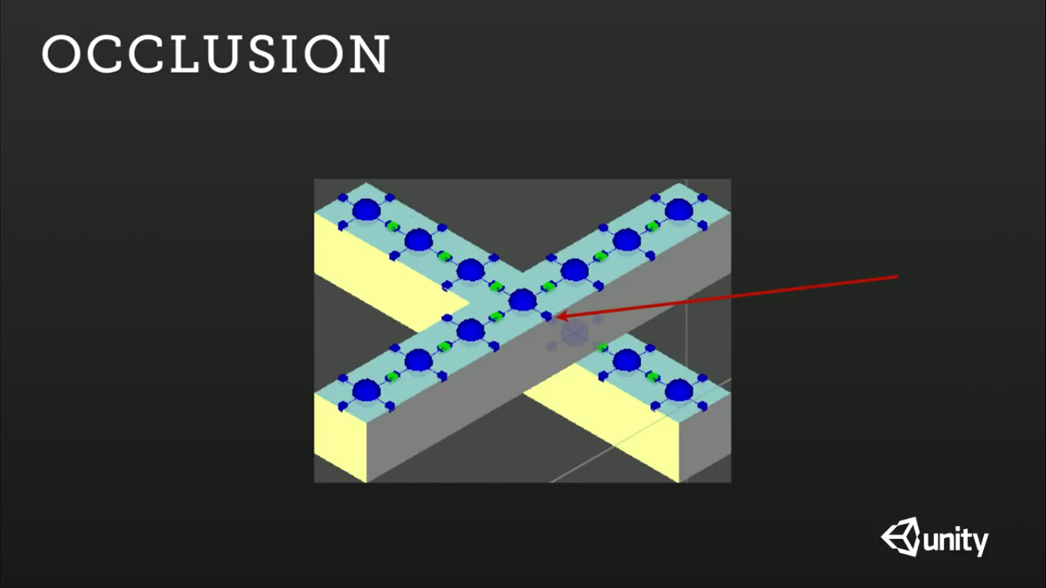

Slide 11
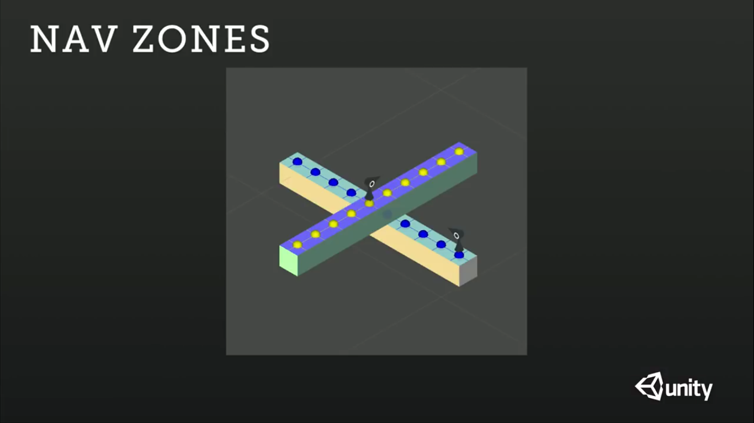

Slide 12
Thank you! Questions?

Slide 13
Sources
Article
http://www.develop-online.net/tools-and-tech/unity-focus-monument-valley/0196004
Gameplay
https://www.youtube.com/watch?v=zchEMcZtI3M
Talk
https://www.youtube.com/watch?v=mCCC9hQm6MM

